Slide 1
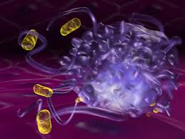
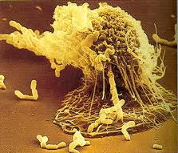
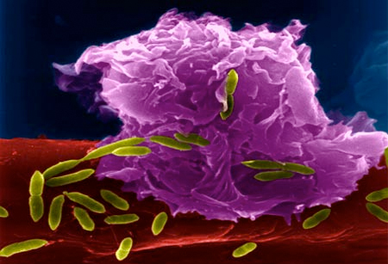
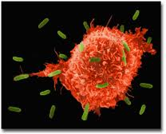
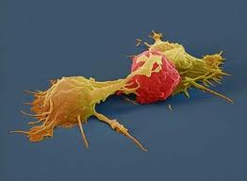
  Infectious Diseases
  Lesson 5.2

Slide 2
Lesson Objectives:
After finishing today’s lesson, you will be able to:
explain the differences between how B and T cell receptors bind to an antigen.
describe how randomly generated B and T cell receptors allow the immune system to ‘see’ evolving pathogens.
explain the need for clonal expansion.

Slide 3
Do Now
Why might the innate response be unable to control an infection?

Slide 4
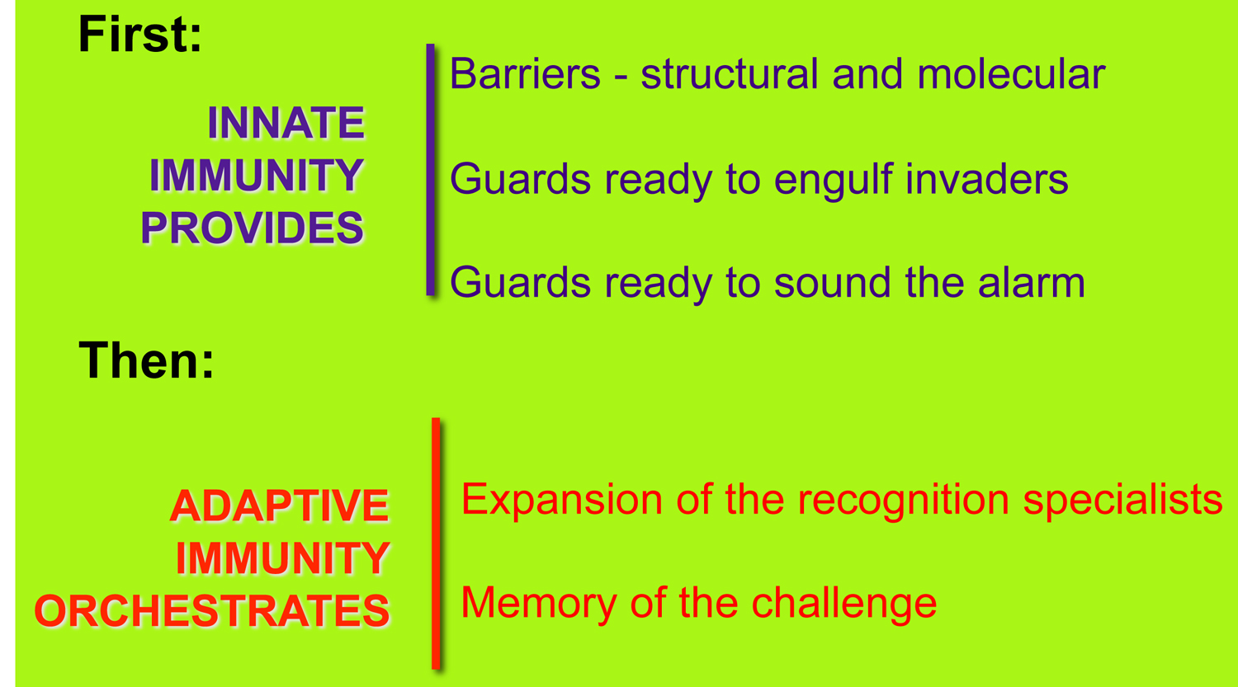
The immune system works in multiple levels:
What happens when innate immunity fails
to clear an infection?

Slide 5
What is the difference between innate and adaptive immunity?
Adaptive cells do not see general structures; they bind very specific molecules (like recognizing finger prints vs. hands).
The adaptive response is pathogen-specific.
Adaptive responses take time and save memories.

Slide 6
Adaptive immune cells are called
Lymphocytes
B lymphocytes:
- Secrete antibodies.
T lymphocytes:
- Some help activate immune system responses.
  - Others attack and kill cells infected with bacteria or viruses.

Slide 7
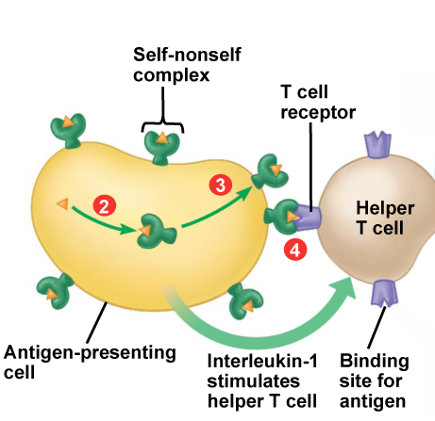
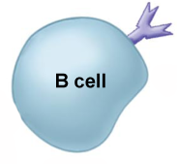
Adaptive cells ‘see’ Antigens
Antigens are:
  Not usually found in the host – they are specific to the pathogen.
They are recognized by specific receptors on B and T cells.
The B cell receptor can be attached to the cell surface …
The T cell receptor binds antigen that is presented by an innate cell
….or released from the cell surface as an antibody.

Slide 8
Activity
At your table, take 5 minutes to complete questions 1 and 2 in your worksheet.

Slide 9
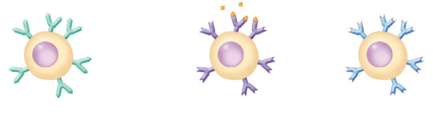
Design an antibody
Each B cell has a randomly designed antibody on its surface.
This happens via gene V(D)J recombination.
B cell with antibodies

Slide 10
Demonstration of cutting and pasting
V_{H}
D
J
V_{L}
J
1
2
3
1
3
1
2
2
3
1
2
1
2
1
2
3
2
Genomic DNA
of the B cell

Slide 11
Do you ‘see’ a pathogen?

Slide 12
B and T cell receptors are made randomly; what if we don't have an antibody to 'see' a pathogen?
Each one of us makes B and T cells with different receptors in the order of 10⁷ due to recombination. But the potential to make cells with novel receptors is estimated to be higher: up to 10¹³ B cell and 10¹⁸ T cell receptors. This is practically infinite!
Pathogens have more than one antigen, so we almost always have antibodies that recognize pathogens.

Slide 13
  Each B cell and T cell has receptors specific for a single antigen
  They lurk in the lymphatic system
  If they meet ‘their’ antigen they will respond!
Pathogens with Antigens
B cell with antibodies
Only the B cells that ‘see’ their antigen respond!

Slide 14
Wrap Up
    At your table, discuss the following question:
      Each B and T cell has a unique receptor that was made randomly. So, if an individual B cell has a receptor that recognizes H1N1, how can this lone cell help control the infection?

Slide 15
Wrap Up
Antigen
Molecules (yellow)
2
Three types of B cells with different antigen receptors: represented in green, purple and blue
First exposure
to antigen
Clonal expansion of antigen specific cells
Binding antigen causes B and T cells to replicate: clonal expansion.
This creates a pool of adaptive recognition specialists!

Slide 16
Homework
Use the immune system and pathogen cards to review the major concepts from today’s lesson in preparation for Lesson 5.4:
Putting it all together – a card game.

